Slide 1
Elsevier Case Study

Slide 2
Contains
Performing RFM analysis in Tableau
Performing Market basket Analysis in Python

Slide 3
Data Cleaning \ Corrections
Removed 00:00:00 from the date columns
Changed Transaction types ‘Returns’ to ‘Returns’

Slide 4
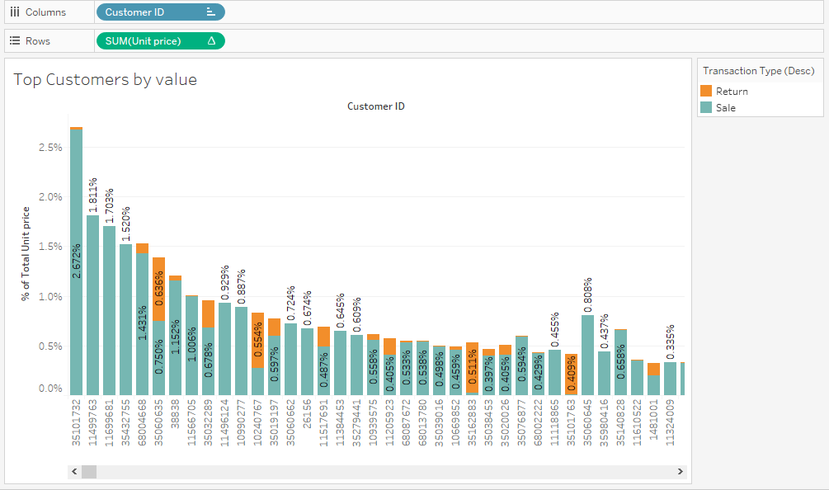
Exploratory Analysis

Slide 5
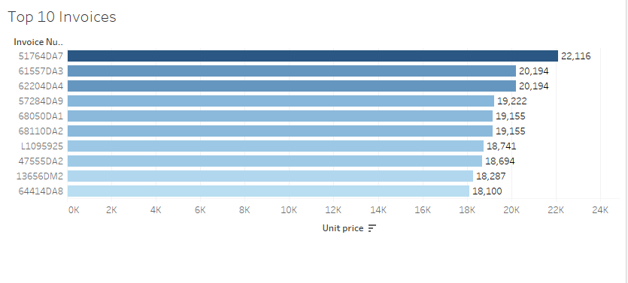
Top 10 Invoice items by sales

Slide 6
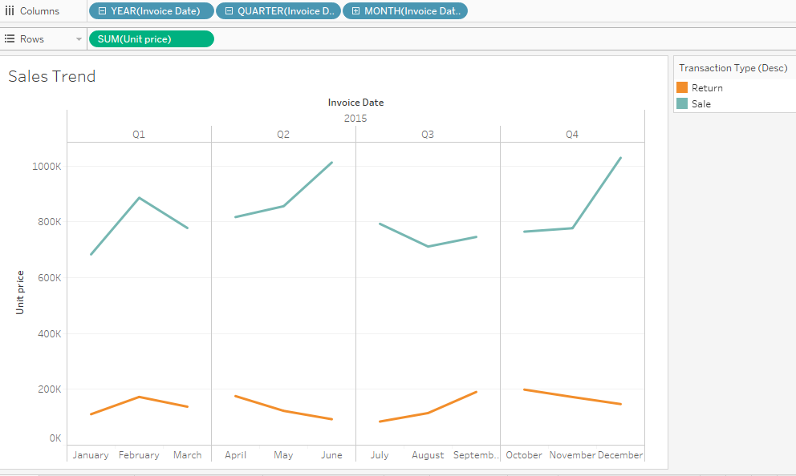
Sales Trend

Slide 7
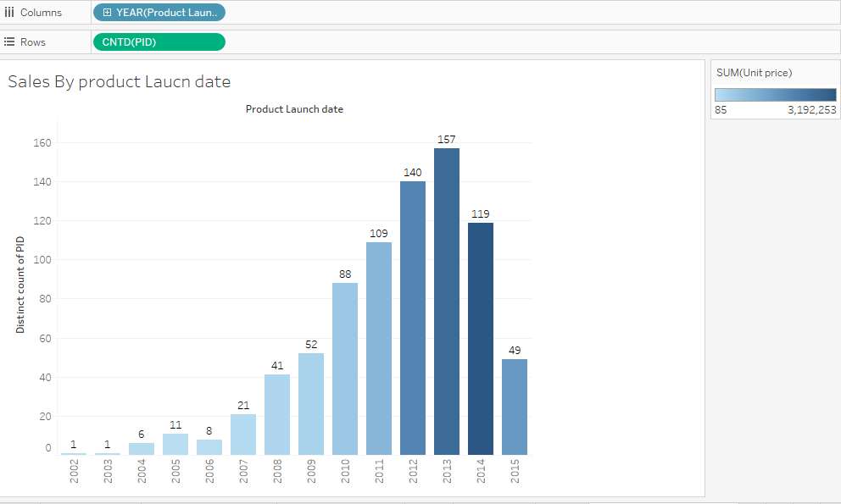
New Product Launces each year

Slide 8
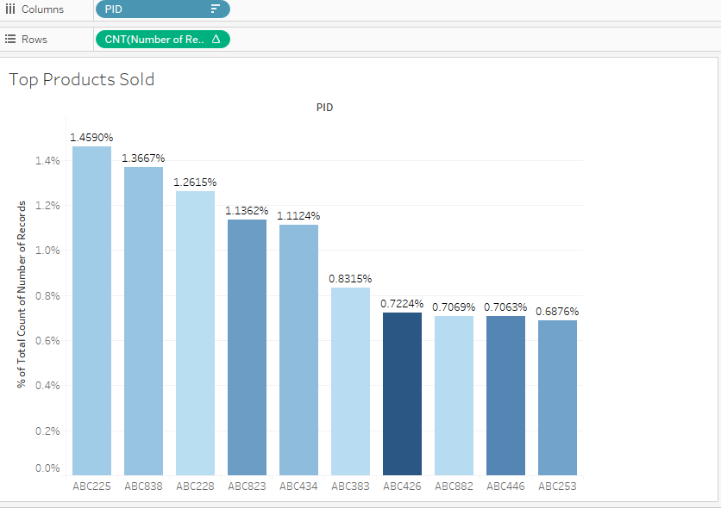
Top Products Sold

Slide 9
RFM Segment Calculations
Recency Percentile
RANK_PERCENTILE(MIN(DATEDIFF('day',[Invoice Date],TODAY())),'asc’)
Frequency Percentile
RANK_PERCENTILE(SUM([Number of Records]),'asc’)
Monetary Percentile
RANK_PERCENTILE(SUM([Unit price]))
Convert percentile to range 1 to 5
RFM
[Recency]*100+[Frequency]*10+[Monetary]

Slide 10
Create Customer Segment
RFM = 555 will indicate best customers
RFM = 111 will indicate worst customers
IF REGEXP_MATCH(STR([RFM]),'555') THEN "Best Customers"
ELSEIF REGEXP_MATCH(STR([RFM]),'[1-5][1-5]5') THEN "Big Spenders"
ELSEIF REGEXP_MATCH(STR([RFM]),'[1-5][4-5][1-5]') THEN "Loyal Customers"
ELSEIF REGEXP_MATCH(STR([RFM]),'5[2-5][2-5]') THEN "Recent Customers"
ELSEIF [RFM]=511 OR [RFM]=521 THEN "New Customers"
ELSEIF REGEXP_MATCH(STR([RFM]),'4[1-5][1-5]') THEN "Potential Loyal Customers"
ELSEIF REGEXP_MATCH(STR([RFM]),'3[1-4][1-4]') THEN "Average Customers"
ELSEIF REGEXP_MATCH(STR([RFM]),'1[2-5][2-5]') THEN "At Risk Customers"
ELSEIF REGEXP_MATCH(STR([RFM]),'2[1-5][1-5]') THEN "Almost Lost Customers"
ELSEIF REGEXP_MATCH(STR([RFM]),'1[2-3][2-3]') THEN "Lost Customers"
ELSEIF [RFM]=111 OR REGEXP_MATCH(STR([RFM]),'1[1-2][1-2]') THEN "Lost Cheap Customers"
ELSE "Others"
END

Slide 11
Customer Segments

Slide 12
Product Recommendation using Python
Packages Used
Pandas
Mlxtend for apriori

Slide 13
Python Code
import pandas as pd
sales = pd.read_csv('sales.csv')
#Show sales data
sales
#Check IsNa
sales.isnull()
sales.describe()
#Convert row wise data to column wise data. Each product will have one column
basket = (sales[sales['Transaction Type (Desc)'] =="Sale"]
.groupby(['Invoice Number', 'PID'])['Delivered Qty']
.sum().unstack().reset_index().fillna(0)
.set_index('Invoice Number'))
from mlxtend.frequent_patterns import apriori
from mlxtend.frequent_patterns import association_rules
#perform apriori analysis. Set
frequent_itemsets = apriori(basket_sets, min_support=0.0025, use_colnames=True)
#Find Recomemendations
rules = association_rules(frequent_itemsets, metric="lift", min_threshold=0.01)
rules

Slide 14
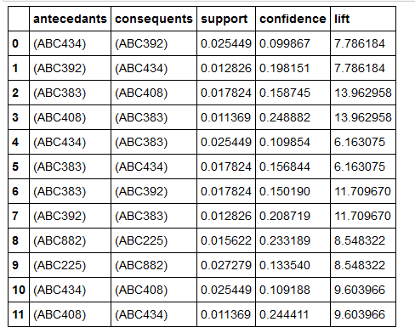
Associated product recommendations

Slide 15
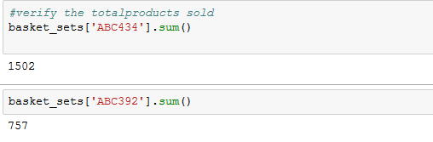
Cross Checking
Products ABC434, ABC392 are sold together

